Slide 1


Practice. Simple server on Node.js
Excellence in Software Engineering
Created by
ievgen_aznaurov@epam.com

Slide 2
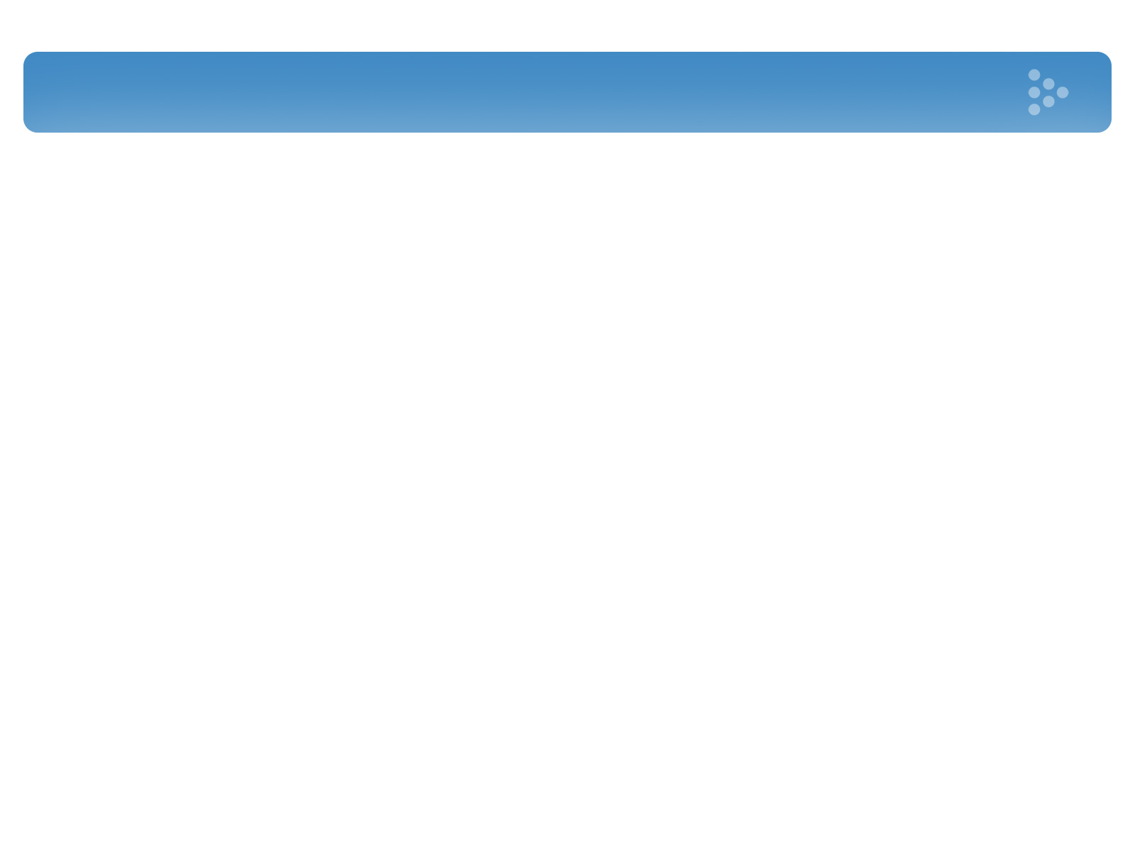
Agenda
Preparing the environment
Basics
Hello world app Activating blog with Node.js
+ Express.js

Slide 3

MacOS Node.js Setup
1. http://nodejs.org/
2. Brew
Notes:
3

Slide 4
Windows Node.js Setup
1. http://nodejs.org/
1. http://nodejs.org/
Notes:
4

Slide 5
Ubuntu Node.js Setup
Plan A:
apt-get install python-software-properties
apt-add-repository ppa:chris-lea/node.js
apt-get update
apt-get install nodejs
node -v
npm -v
Plan B:
apt-get install npm
Notes:
5

Slide 6
Basics and
Hello World App
Notes:
6

Slide 7
Activating blog with Node.js
Notes:
7

Slide 8
+ Express.js
Notes:
8

